Slide 1
Entity Relationship Model
Unit - 2

Slide 2
Entities and Attributes
Entity:
A thing or an object.
It has set of properties
Values for some set of properties, it can uniquely identify it
Entities are specific objects or things in the mini-world that are represented in the database.
For example the EMPLOYEE John Smith, the Research DEPARTMENT, the ProductX PROJECT
Attributes are properties used to describe an entity.
For example an EMPLOYEE entity may have the attributes Name, SSN, Address, Sex, BirthDate
A specific entity will have a value for each of its attributes.
For example a specific employee entity may have Name='John Smith', SSN='123456789', Address ='731, Fondren, Houston, TX', Sex='M', BirthDate='09-JAN-55‘
Each attribute has a value set (or data type) associated with it – e.g. integer, string, subrange, enumerated type, …

Slide 3
Type of Attributes
Simple Attribute
Each entity has a single atomic value for the attribute.
For example: SSN or Gender.
Composite Attribute
An attribute where the values of that attribute can be further subdivided into meaningful sub-parts."
For Example: Emp_Name – may be stored as first name, last name, middle initial
Address(Apt#, House#, Street, City, State, ZipCode, Country)
Multivalue Attribute
An attribute that can have more than one value associated with the key of the entity.
For Example: Degree of a person, Hobby of a person, Bank branch Location, Color of a car etc.
Derived Attribute
An attribute whose value is calculated (derived) from other attributes.
The derived attribute need not be physically stored within the database; instead, it can be derived by using an algorithm.
For Example: Age field (can be derived from Birth_date field)

Slide 4
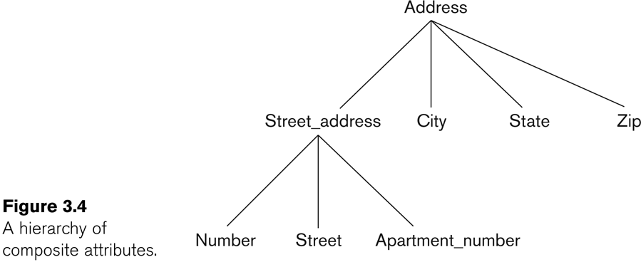
Cont…
In general, composite and multi-valued attributes may be nested arbitrarily to any number of levels, although this is rare.
For example, PreviousDegrees of a STUDENT is a composite multi-valued attribute denoted by {PreviousDegrees (College, Year, Degree, Field)}
Multiple PreviousDegrees values can exist
Each has four subcomponent attributes:
College, Year, Degree, Field

Slide 5
Entity Type and Entity Sets
A database usually contains groups of entities that are similar
For Ex. Company Employees
Each entity shares the same attribute but each entity has its own values for each attribute
Entity Type: A collection (set of) of entities that have the same attributes
A collection of all entities of a particular entity type in the database at any point in time is called an entity set or entity collection
Entity set is usually referred by using the same name as the entity type.
For Ex.: EMPLOYEE refers to both type of entity as well as the collection ofall employee entities in the Database.

Slide 6
Relationship
A relationship relates two or more distinct entities with a specific meaning.
Eg. Employee WORKS FOR Department -------”Work For” is the relationship
Student ENROLLS Course -----------”Enrolls” is the relationship
A relationship type R among n entity types E1, E2, ..., En defines a set of associations—or a relationship set—among entities from these entity types.
As for the case of entity types and entity sets, a relationship type and its corresponding relationship set are customarily referred to by the same name, R.

Slide 7
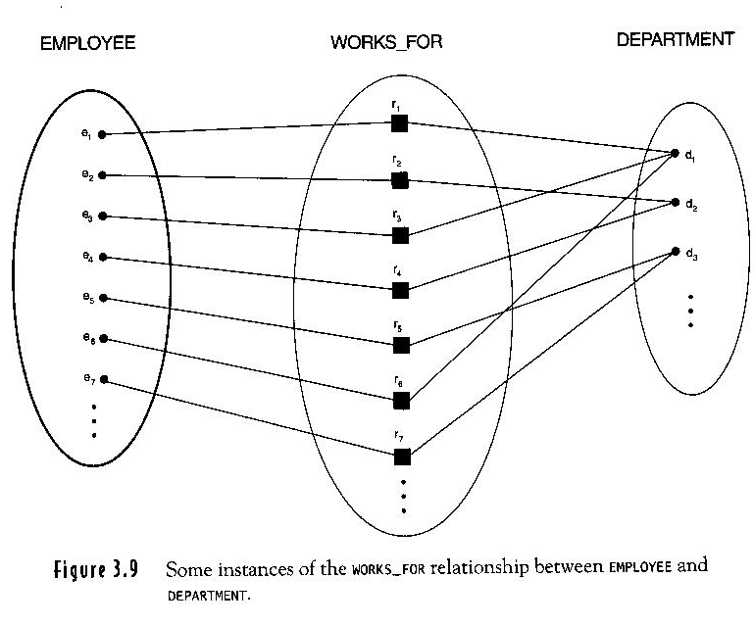
Relationship instances
In the mini-world represented by figure below employees e1, e2, e3 and e6 work for department d1, e2 and e4 works for d2 and e5 and e7 work for d3.

Slide 8
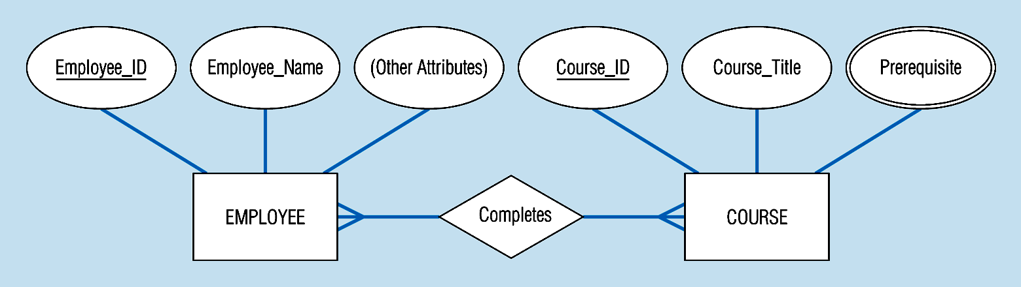
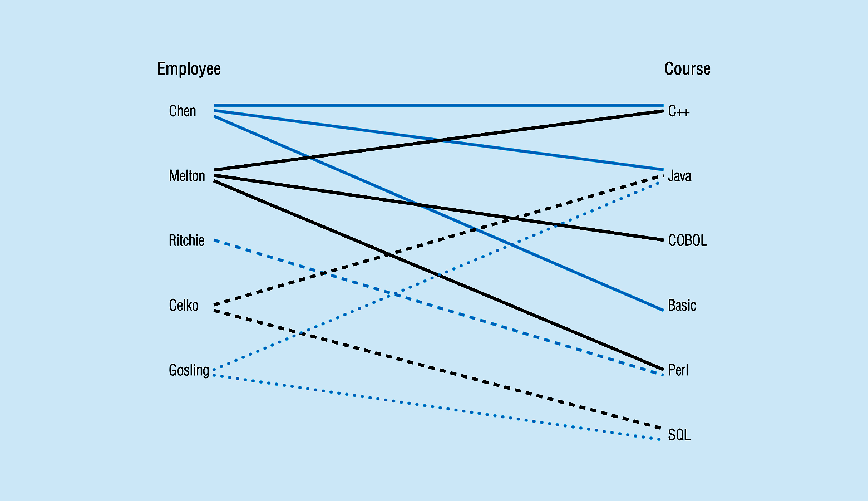
Relationship types and instances
Notes:
17

Slide 9
Relationship type vs. relationship set
Previous figures displayed the relationship sets
Each instance in the set relates individual participating entities – one from each participating entity type
In ER diagrams, we represent the relationship type as follows:
Diamond-shaped box is used to display a relationship type
Connected to the participating entity types via straight lines

Slide 10
Relationship type vs. relationship set
Relationship Type:
Is the schema description of a relationship
Identifies the relationship name and the participating entity types
Also identifies certain relationship constraints
Relationship Set:
The current set of relationship instances represented in the database
The current state of a relationship type

